Slide 1

Payment Process
Fatime Nur Çelik

Slide 2
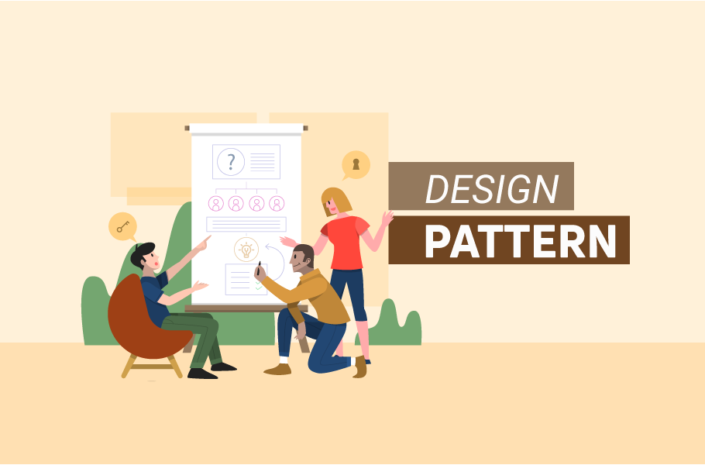
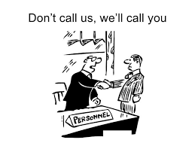
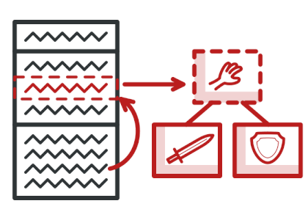
Contents
Template Pattern
Strategy Pattern
Problem
UML Diagram
Summary

Slide 3

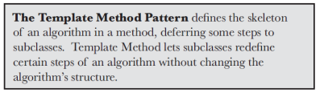
Template Pattern
The Template Method defines the steps of an algorithm and allows subclasses to provide implementation for one or more steps. We don't need to rewrite the steps common to this method.
Maximizes reuse

Slide 4
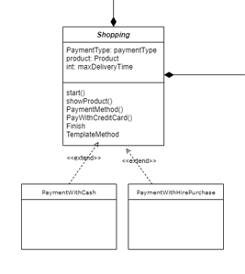

Slide 5

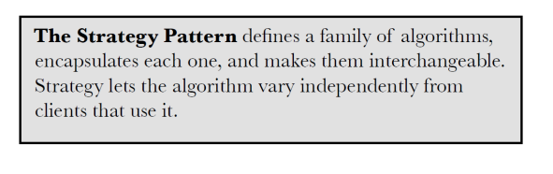
Strategy Pattern
In Strategy pattern, a class behavior or its algorithm can be changed at run time.
In Strategy pattern, we create objects which represent various strategies and a context object whose behavior varies as per its strategy object. The strategy object changes the executing algorithm of the context object.

Slide 6
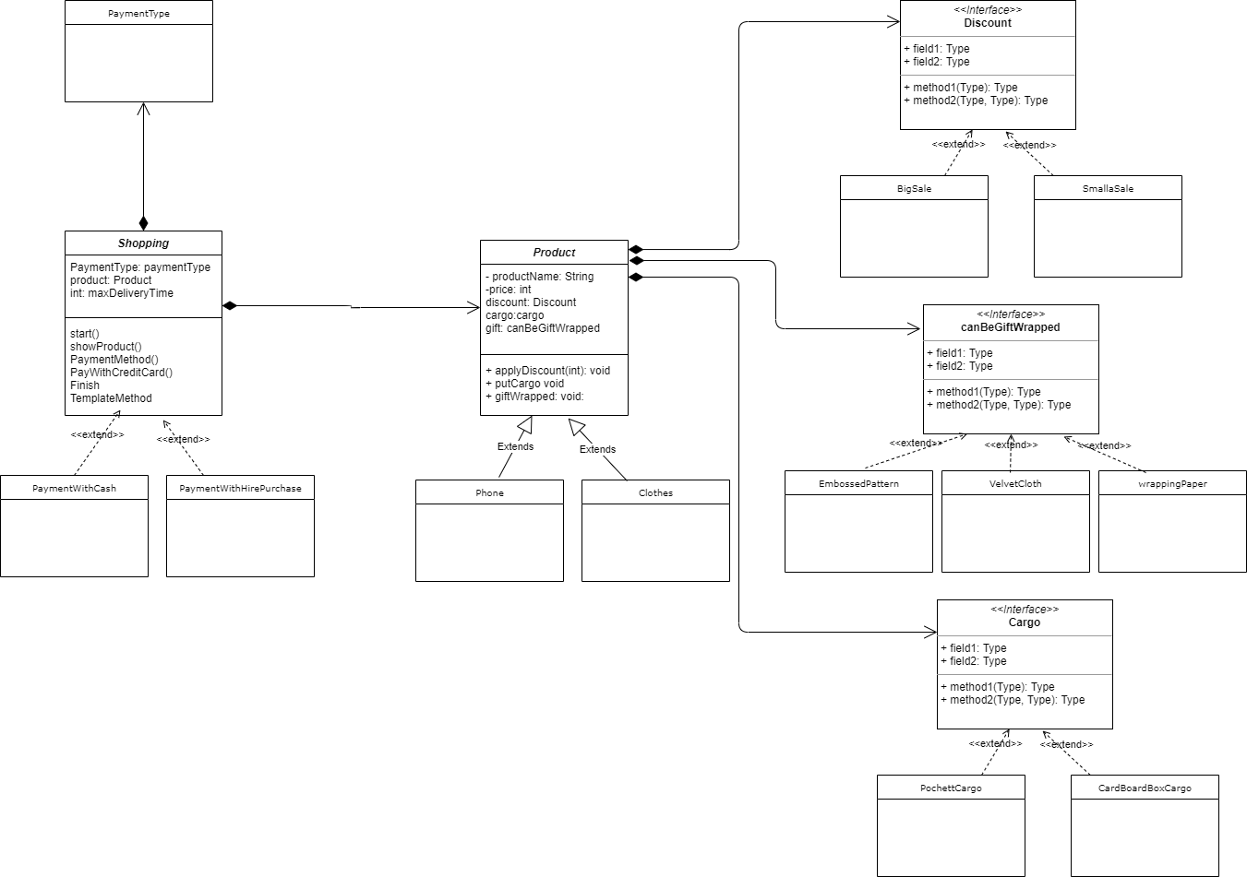

Slide 7
Problem
I made a program that can be used for online payments. The problem that I am trying to solve in the program is the problems that the different stages of cash and installment payment have brought and can bring. At the same time, I aimed to solve the time problem and code complexity problem that may occur when we want to add additional behaviors to our payments.

Slide 8
UML Diagram

Slide 9
Timeline
Decide on an idea
This was the hardest part
Template Pattern
Now that I've decided, I've laid the foundation for my project using a template pattern.
Strategy Pattern
I thought about the behaviors I could add to my project and then I included the strategy pattern in my project.
Uml Diagram
Complete Project
I digitized my uml diagram which was ready on paper.
After everything was finished, my project was ready.

Slide 10

Thank you

